Slide 1

Exam AZ-305: Designing Azure Infrastructure Solutions Crash Course
Tim Warner

Slide 2
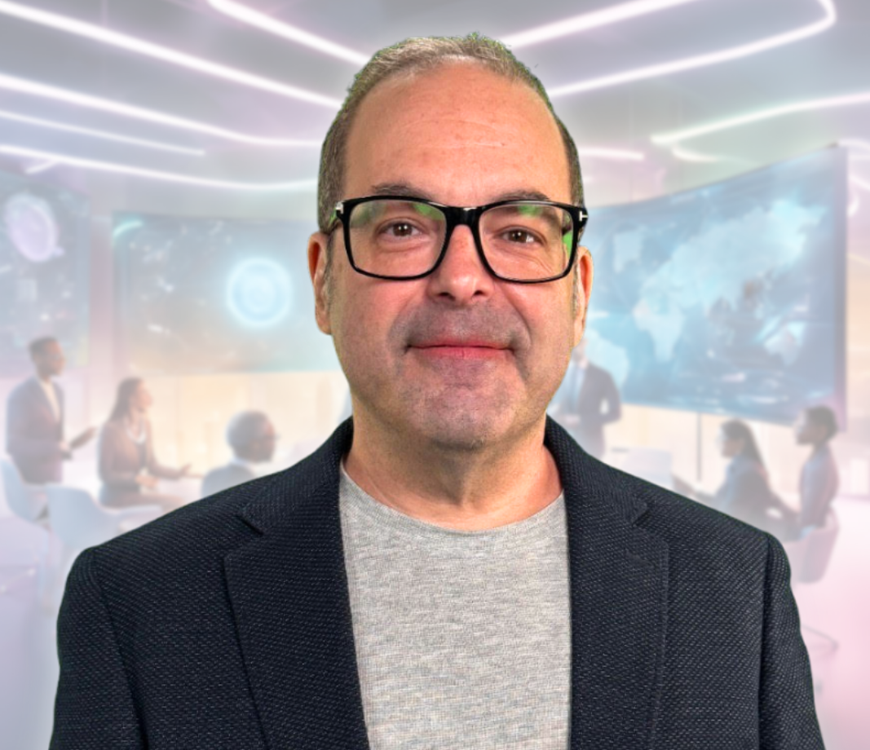
Tim Warner
Based in Nashville, TN, US
28-year Microsoft Certified Trainer (MCT)
6-year Microsoft MVP in Azure AI
Contact: TechTrainerTim.com

Slide 3
Agenda
Cover the exam objectives in themes
The exam is theoretical, not practical
That's why you suffered through AZ-104 ;)
We'll get our hands plenty dirty
Which benefits those learners who haven't yet had the pleasure of meeting AZ-104

Slide 4
Break Schedule (Central Time)
09:00 am - Start Segment 1 (Identity, Governance, Monitoring)
10:00 am - 9-min break - Start Segment 2 (Data Storage Solutions)
11:00 am - 9-min Break - Start Segment 3 (Business Continuity)
12:00 pm - 9-min Break - Start Segment 4 (Infrastructure Solutions)
01:00 pm - 9-min Break - Start Segment 5 (Network Solutions)
02:00 pm - Finish

Slide 5
Course Materials
timw.info/az305

Slide 6
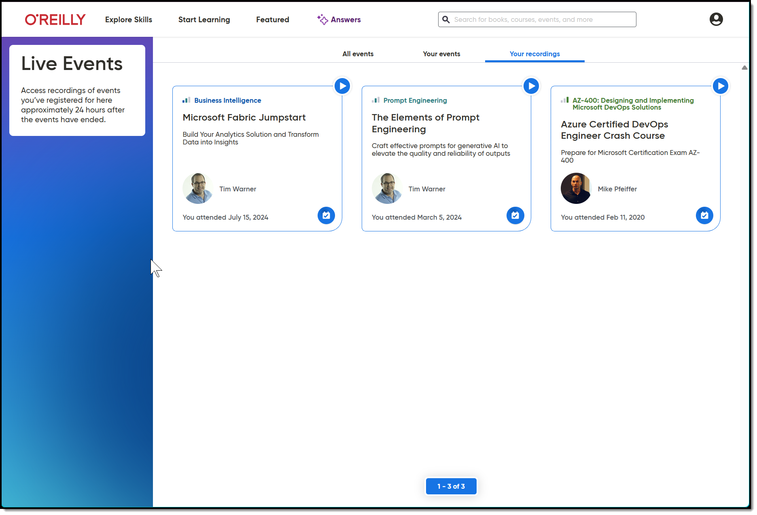
Session Recordings & Badge

Slide 7
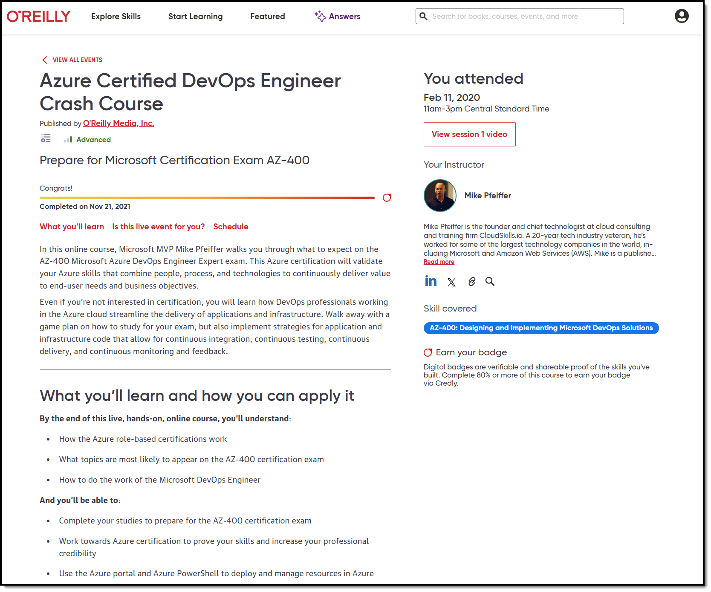
Session Recordings & Badge

Slide 8
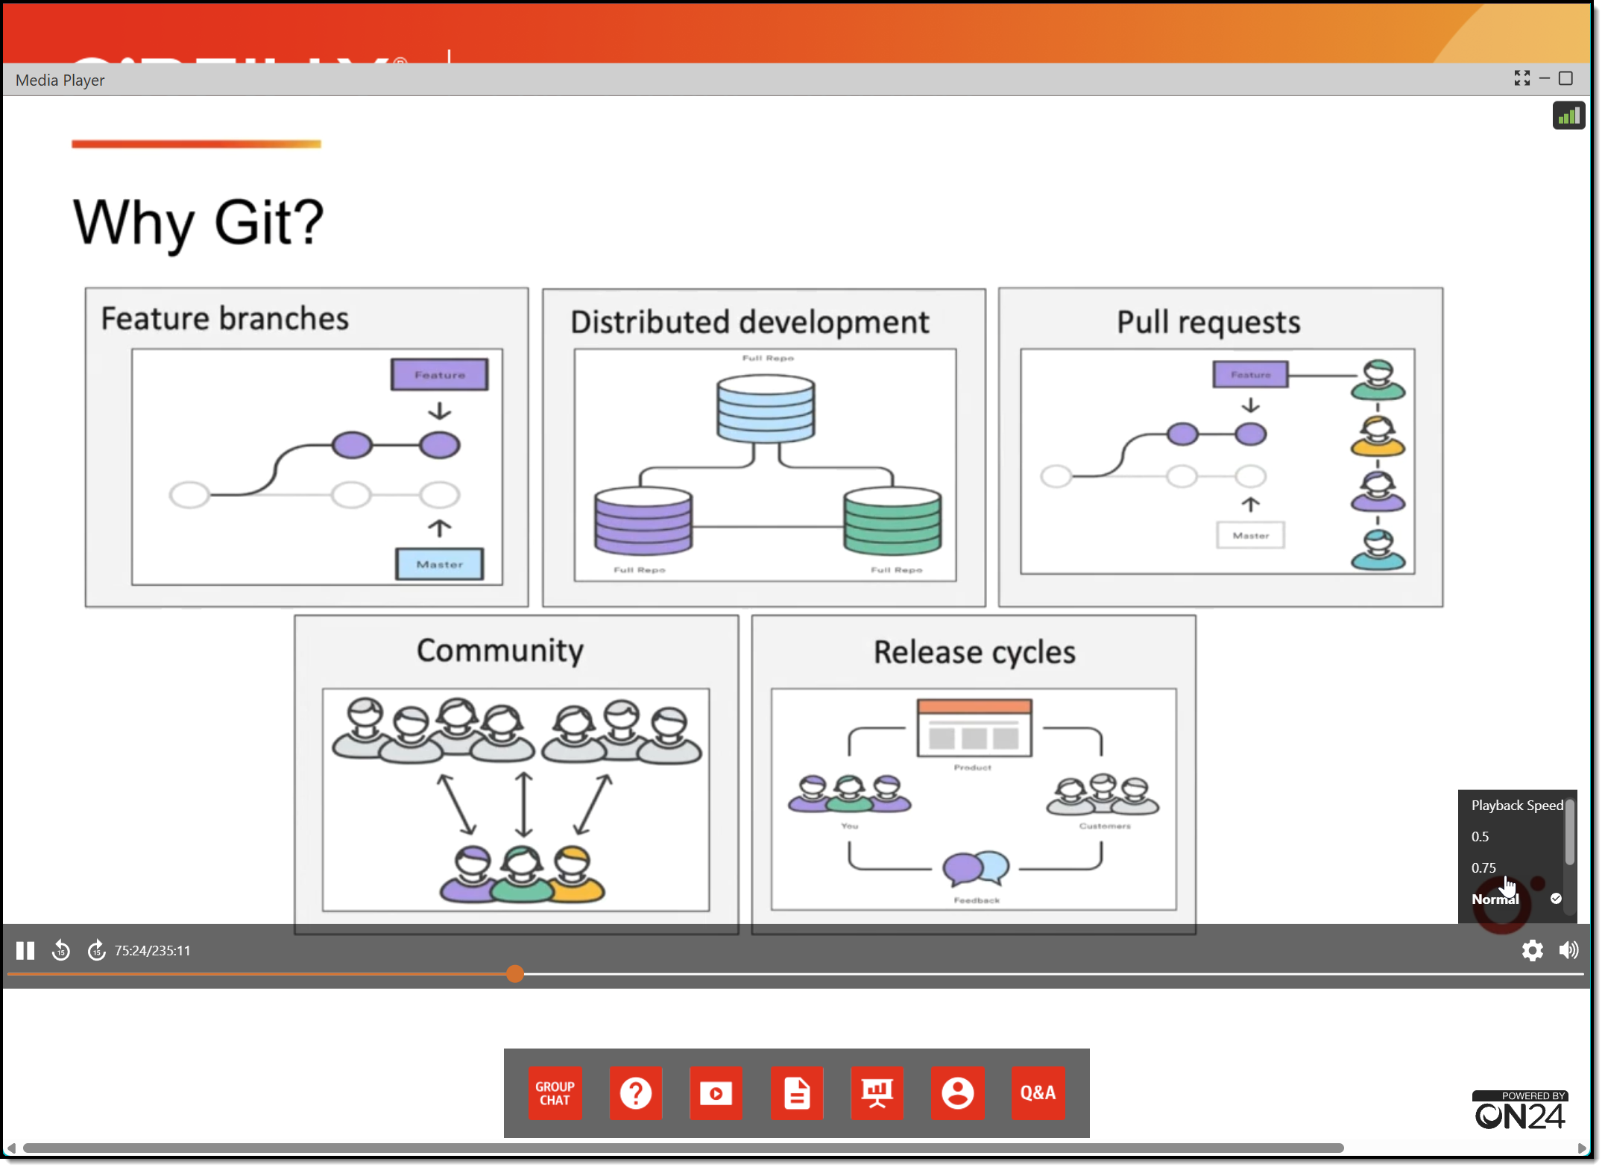
Session Recordings & Badge

Slide 9
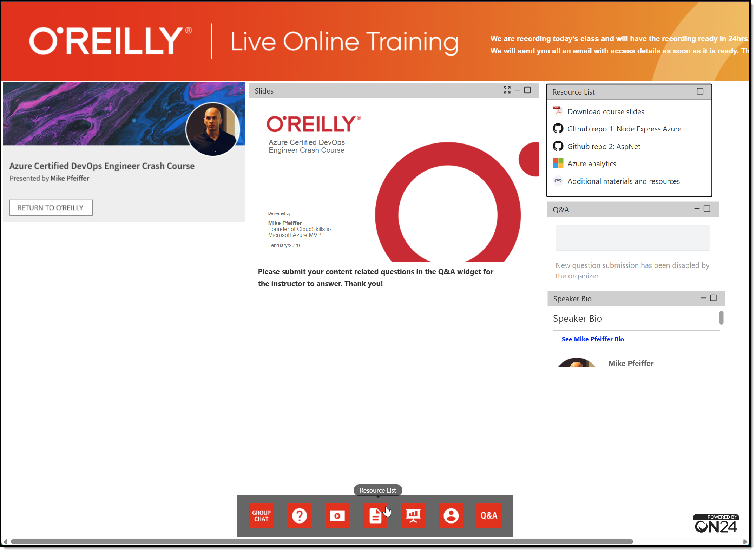
Session Recordings & Badge

Slide 10
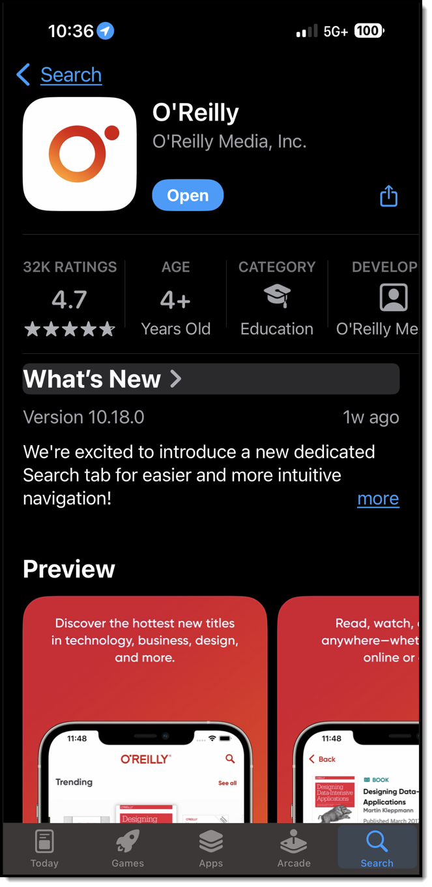
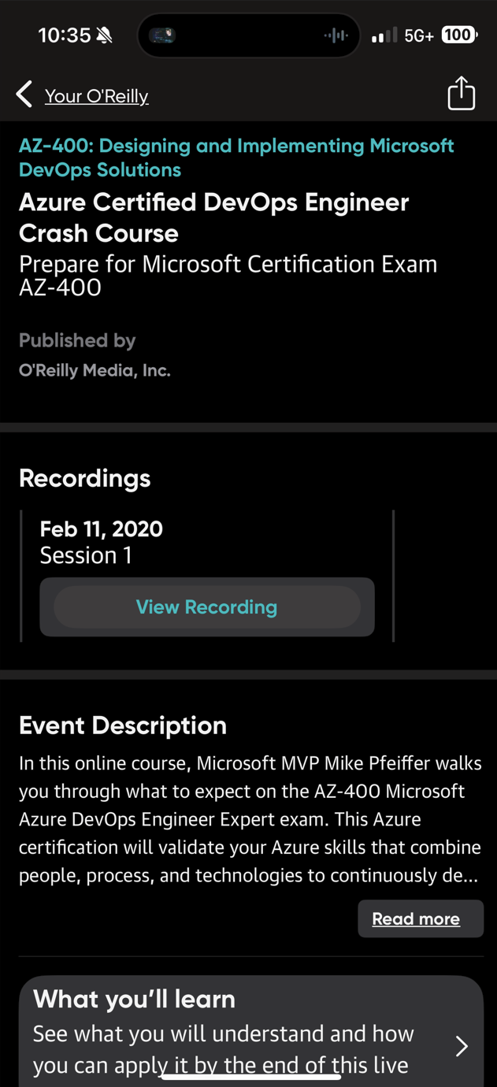
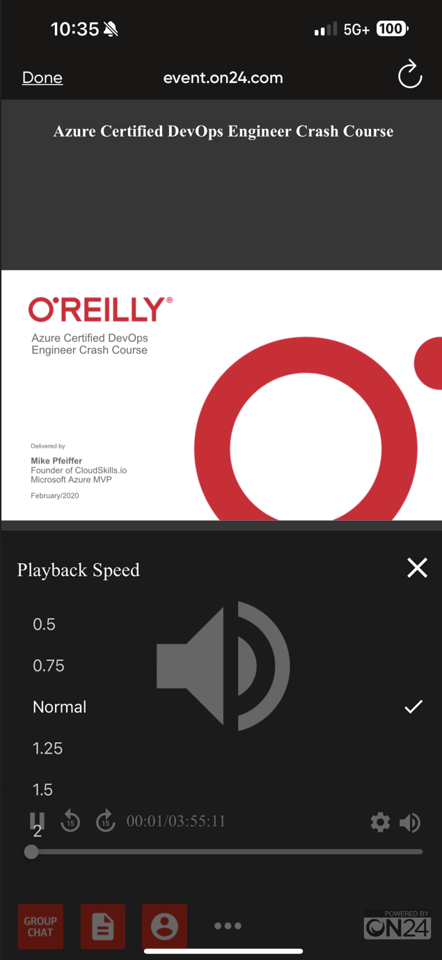
Session Recordings & Badge

Slide 11
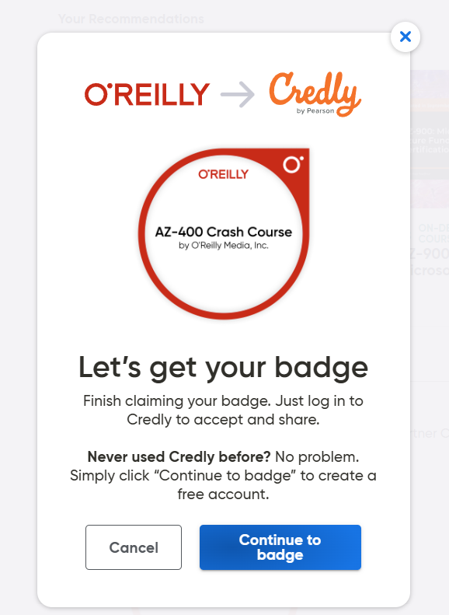
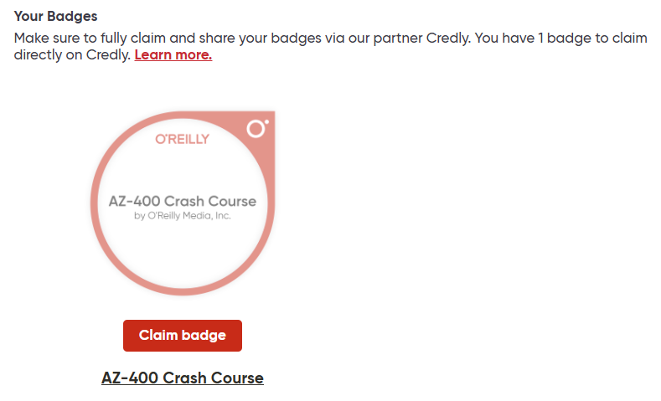
Session Recordings & Badge

Slide 12
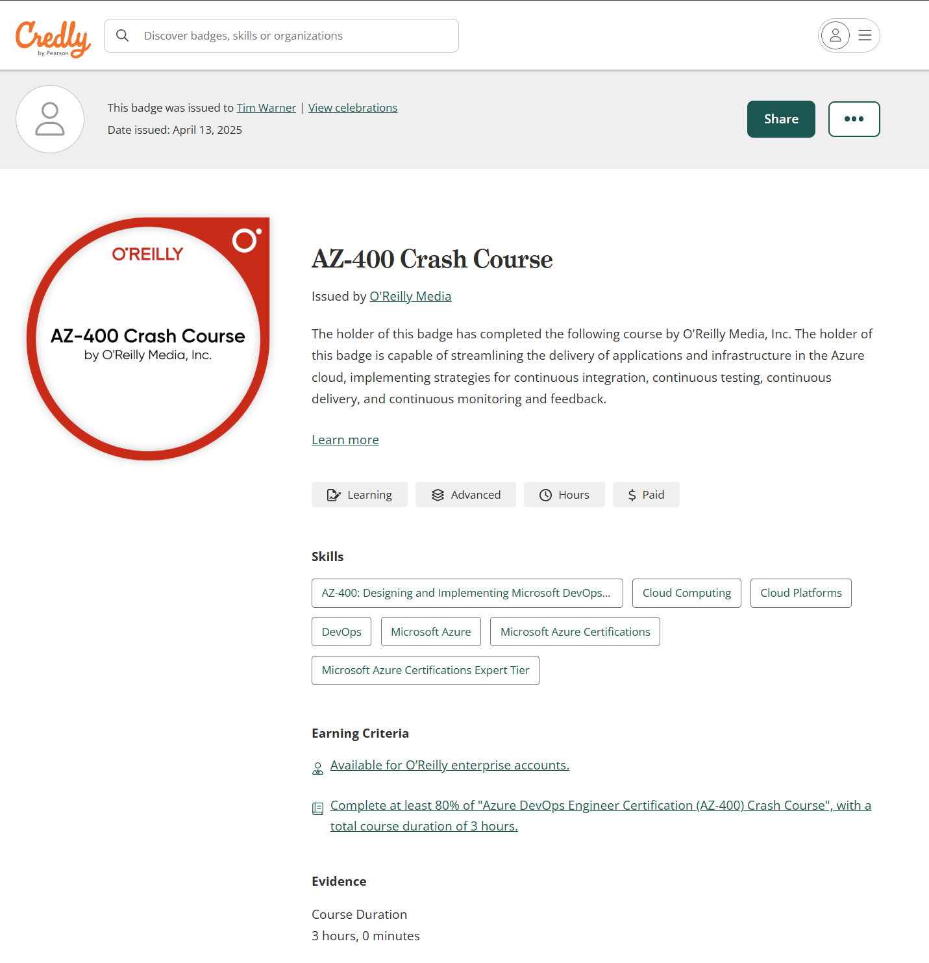
Session Recordings & Badge

Slide 13

Tim's Certification Study Model
Generative AI Support
Core Concepts (Docs)
Knowledge Checks (Tests)
Hands-On Skills (Labs)
Theory (Docs)

Slide 14
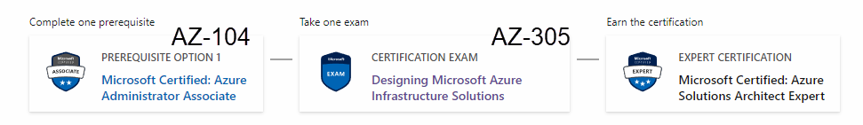
Azure Solutions Architect Expert
One-year validity

Slide 15
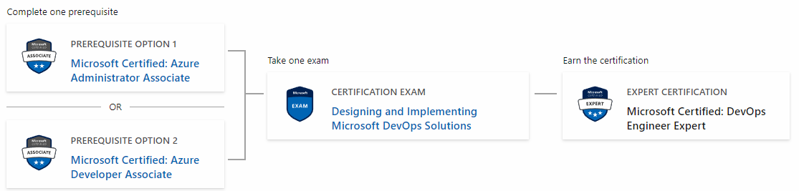
Microsoft DevOps Engineer Expert
AZ-104
AZ-400
AZ-204

Slide 16
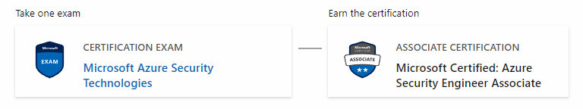
Azure Security Engineer
AZ-500

Slide 17
Critical Microsoft Docs Sites
Cloud Adoption Framework (CAF)
Well-Architected Framework (WAF)
Azure Architecture Center (AAC)

Slide 18
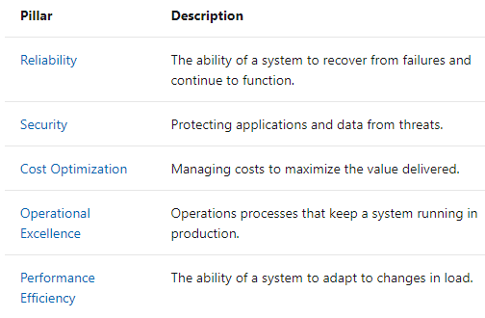
Microsoft Well-Architected Framework

Slide 19
Thank you!
Course materials: timw.info/az305
Contact: TechTrainerTim.com

Slide 20

Azure Monitor

Slide 21

Log Analytics

Slide 22

Sentinel

Slide 23
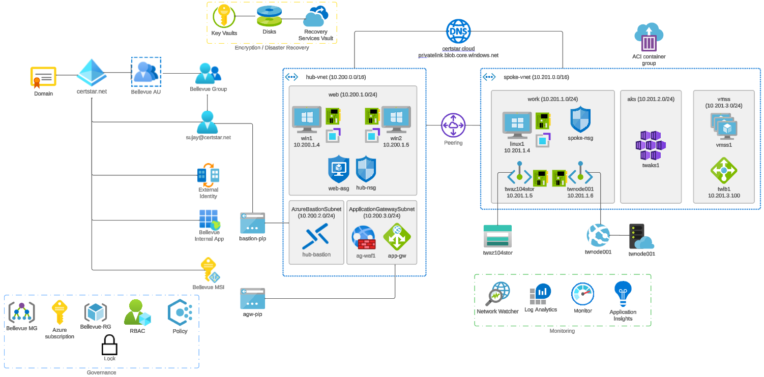


Slide 24

Tenant vs. Subscription

Slide 25

Hybrid Identity

Slide 26

Azure AD B2C

Slide 27
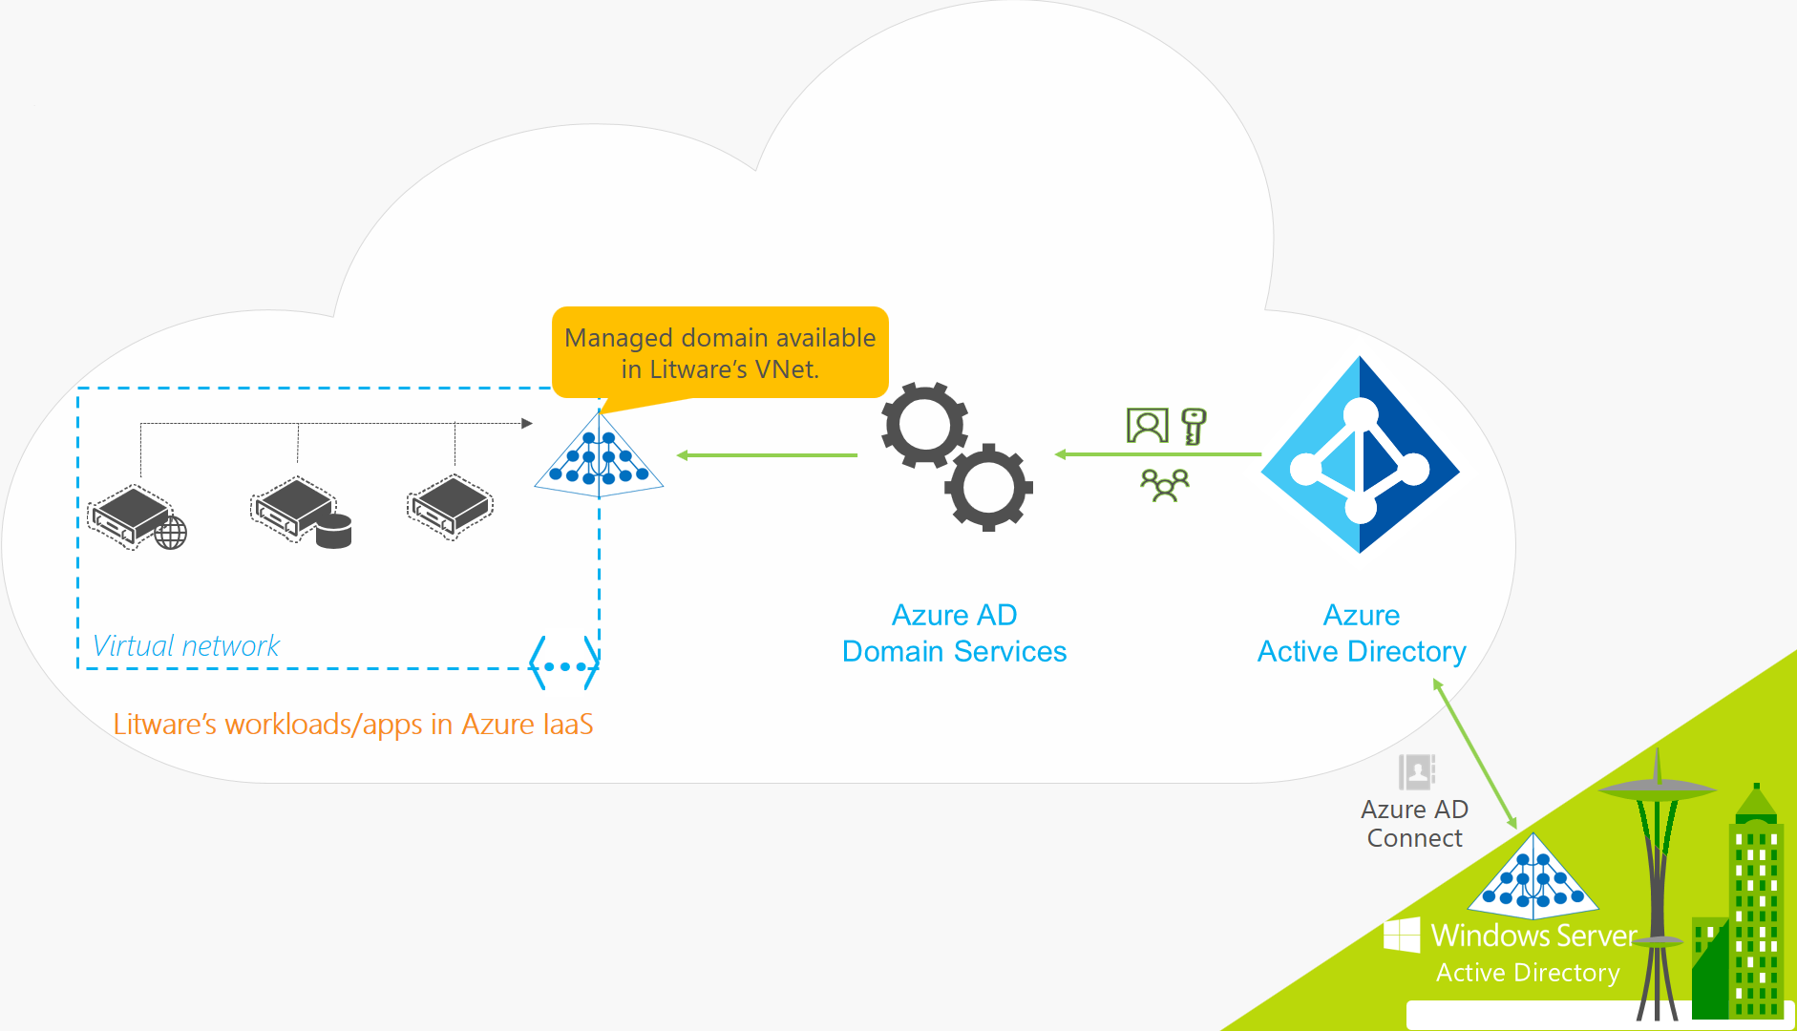
Azure AD Domain Services

Slide 28

Pass-through Authentication

Slide 29

Seamless Single Sign-on

Slide 30

Azure Management Scopes
/ Tenant Root

Slide 31
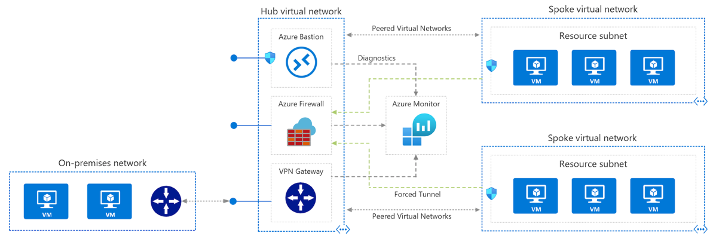
Azure VNet Hub-Spoke

Slide 32
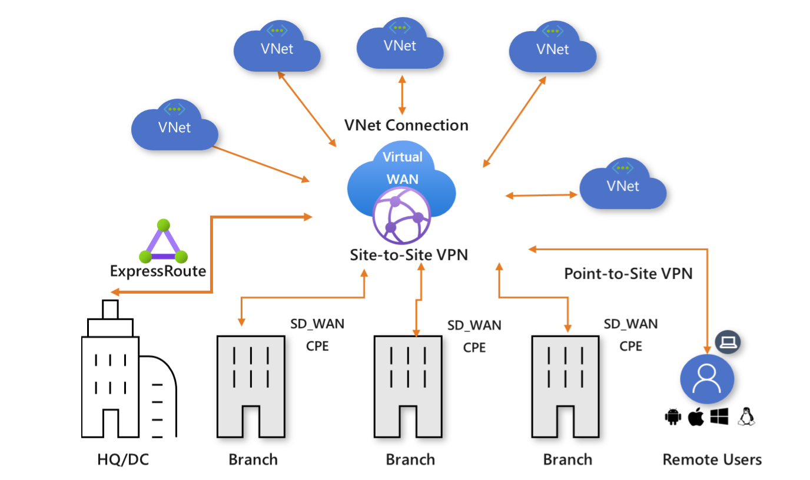
Azure Virtual WAN

Slide 33
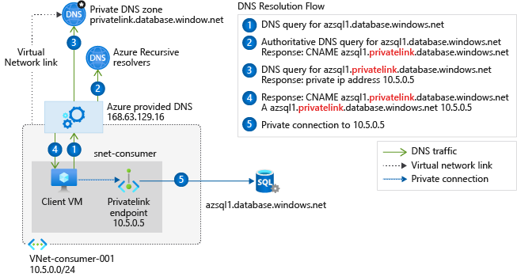
Private Link DNS Configuration

Slide 34

Azure Backup

Slide 35
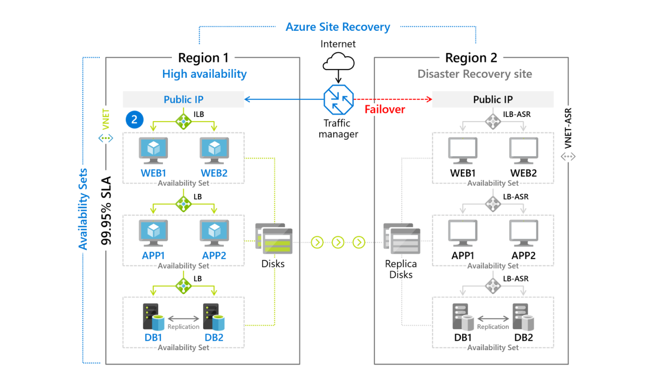
Azure Site Recovery

Slide 36

VM Scale Sets

Slide 37
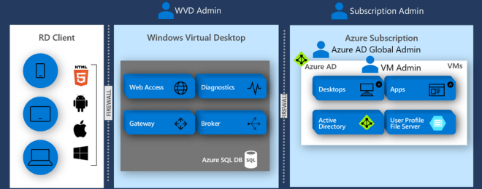
Windows Virtual Desktop (WVD)
timw.info/travis

Slide 38

Availability Set

Slide 39

Availability Zone

Slide 40

VM Networking

Slide 41

Load Balancing

Slide 42

VNet Peering

Slide 43

Hybrid Networking

Slide 44

Network Virtual Appliance

Slide 45

Azure Load Balancer

Slide 46

Application Gateway

Slide 47

Traffic Manager

Slide 48

Front Door Service

Slide 49


Docker Container Lifecycle
https://timw.info/3635f

Slide 50
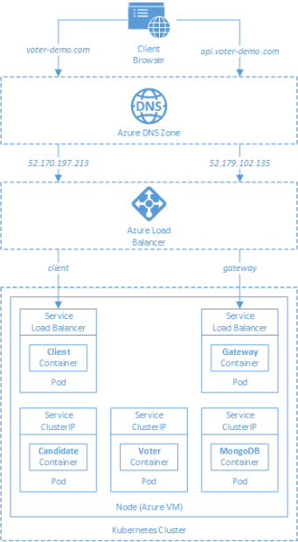
AKS

Slide 51
Azure Backup

Slide 52

Azure Site Recovery

Slide 53
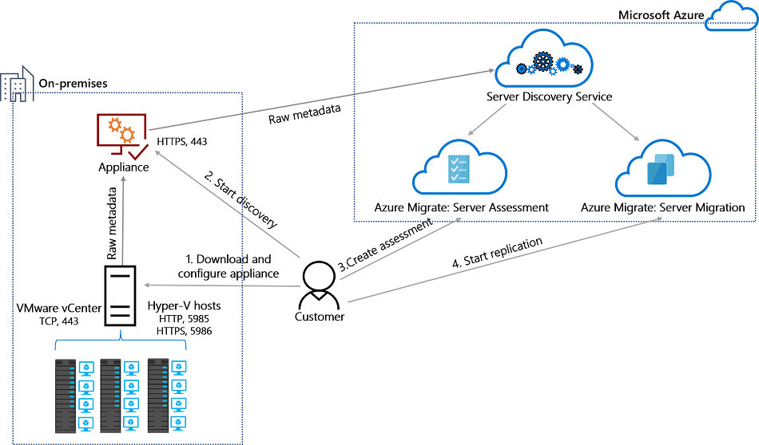
Azure Migrate

Slide 54
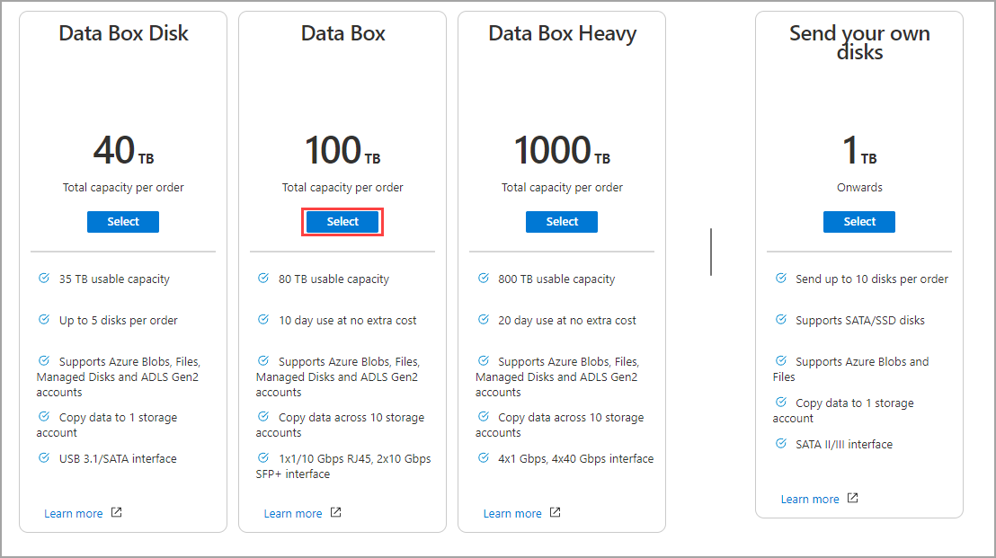
Azure Data Box

Slide 55

Data Pipelines

Slide 56
Storage Account Replication
1
3
3
2
LRS
ZRS

Slide 57
Storage Account Replication
3
3
GRS/RA-GRS

Slide 58
Storage Account Replication
1
3
1
3
2
2
GZRS – RA/GZRS

Slide 59

Always Encrypted

Slide 60
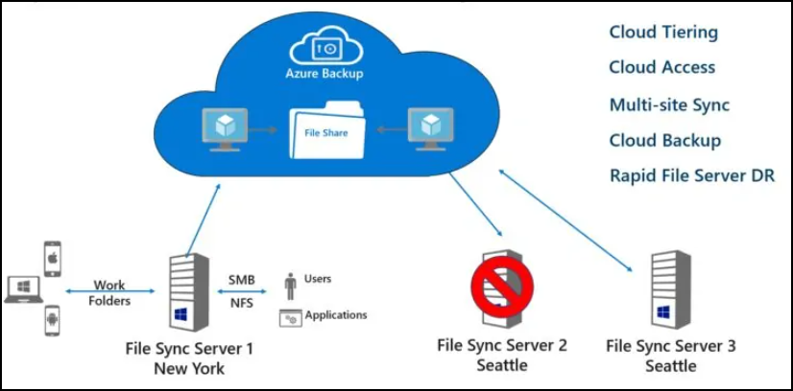
Azure File Sync

Slide 61
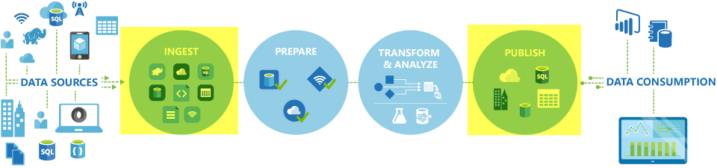
Azure Data Factory

Slide 62

Event Architecture

Slide 63

Event Architecture

Slide 64
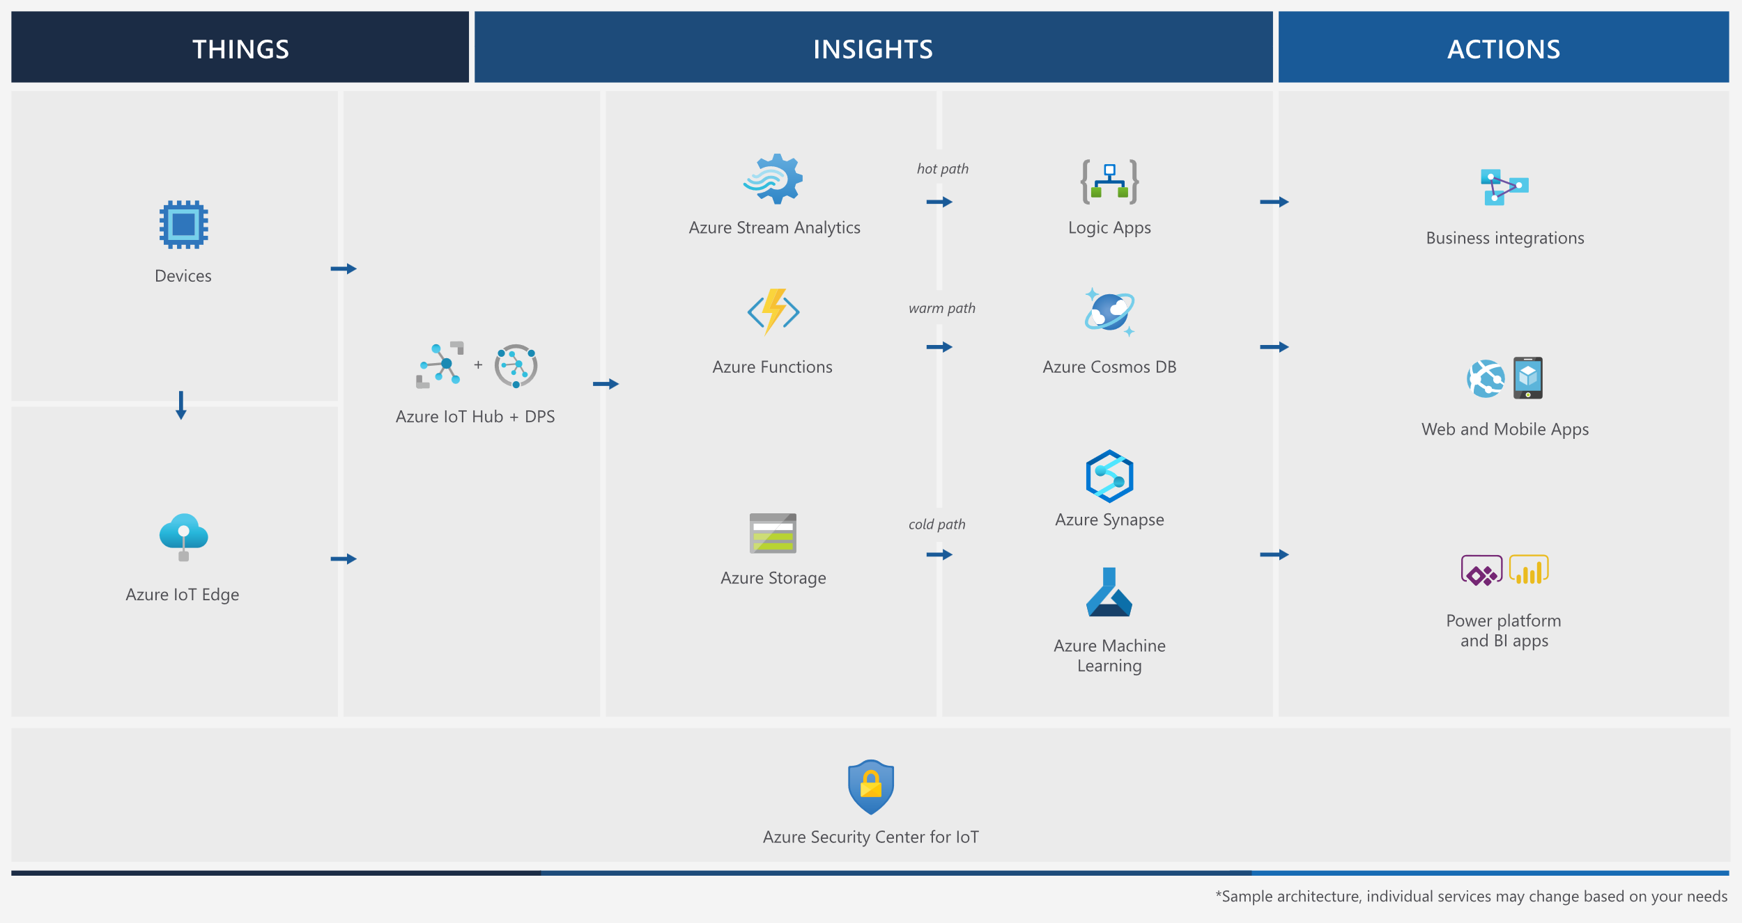
Event Architecture

Slide 65
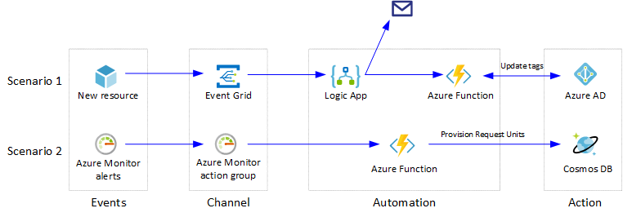
Event Architecture

Slide 66
Exam AZ-304 Item Types

Slide 67

Multiple Choice

Slide 68
Repeated Scenario
You need to move an Azure VM to another hardware host.
Solution: You redeploy the VM.
Does this solution meet the goal?
Yes
No

Slide 69

Select and Place

Slide 70

Build List and Reorder

Slide 71

Active Screen/Fill in the Blank

Slide 72

Case Study

Slide 73






Performance-Based Lab

Slide 74
Microsoft Online Testing

Slide 75
Microsoft Online Testing Process
timw.info/online

Slide 76

Microsoft Online Testing Process

Slide 77

Microsoft Online Testing Process

Slide 78

Microsoft Online Testing Process

Slide 79

Microsoft Online Testing Process

Slide 80

Microsoft Online Testing Process

Slide 81

Microsoft Online Testing Process

Slide 82

Microsoft Online Testing Process

Slide 83

Assemble the Required Materials
Webcam, microphone, and speakers
No headset
Wired or Wi-Fi Internet connection
No VPN
No tethering
Supported OS
Windows, macOS
Smartphone and ID
Mouse-based monitor
No touchscreen

Slide 84
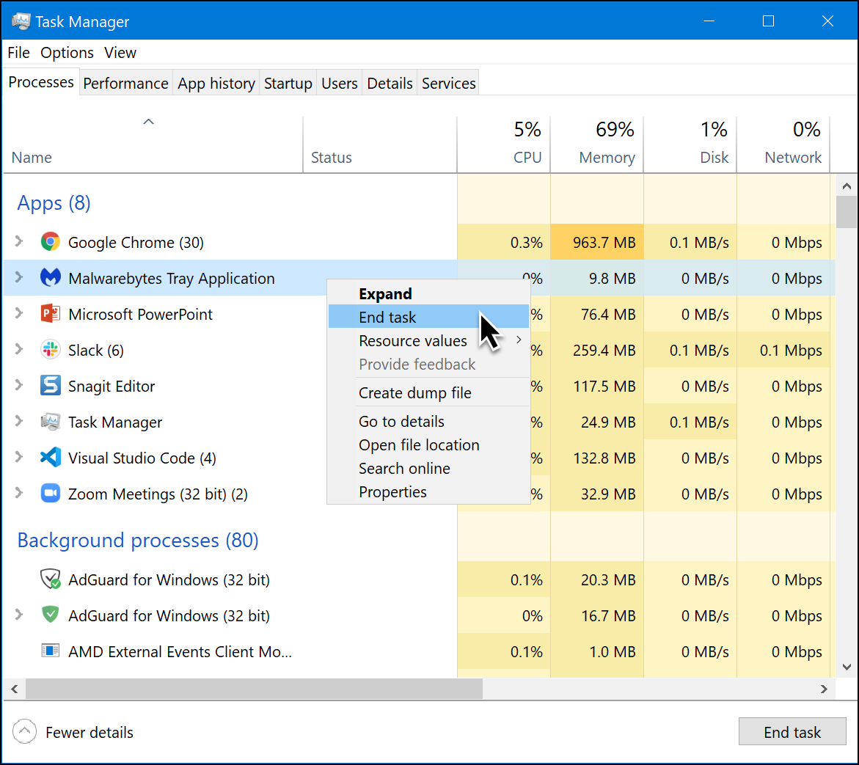
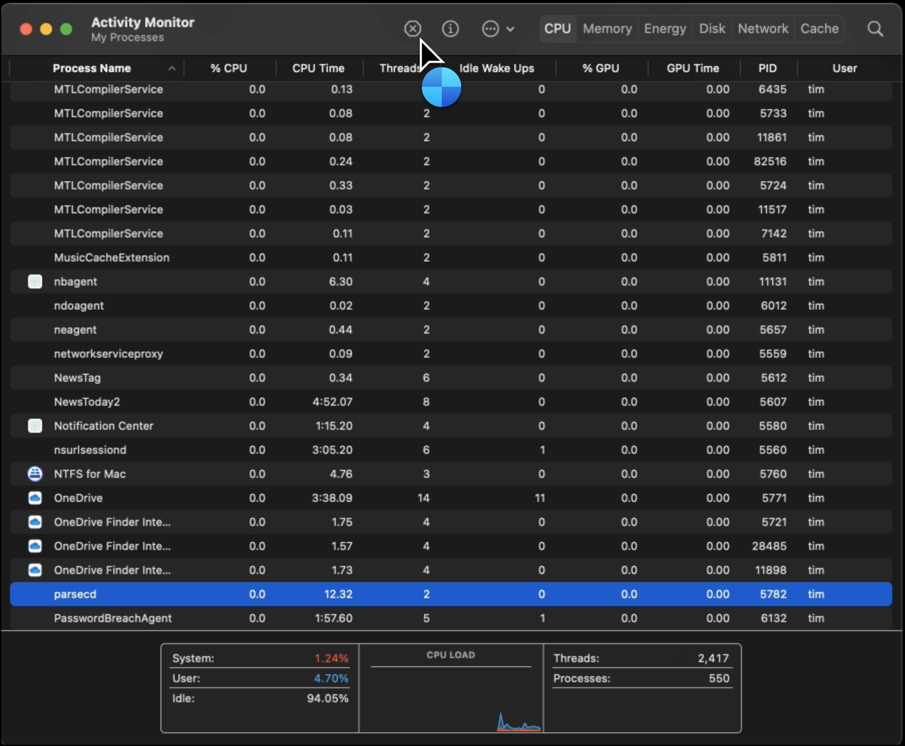
Prepare Your Testing Workstation
Windows
macOS

Slide 85
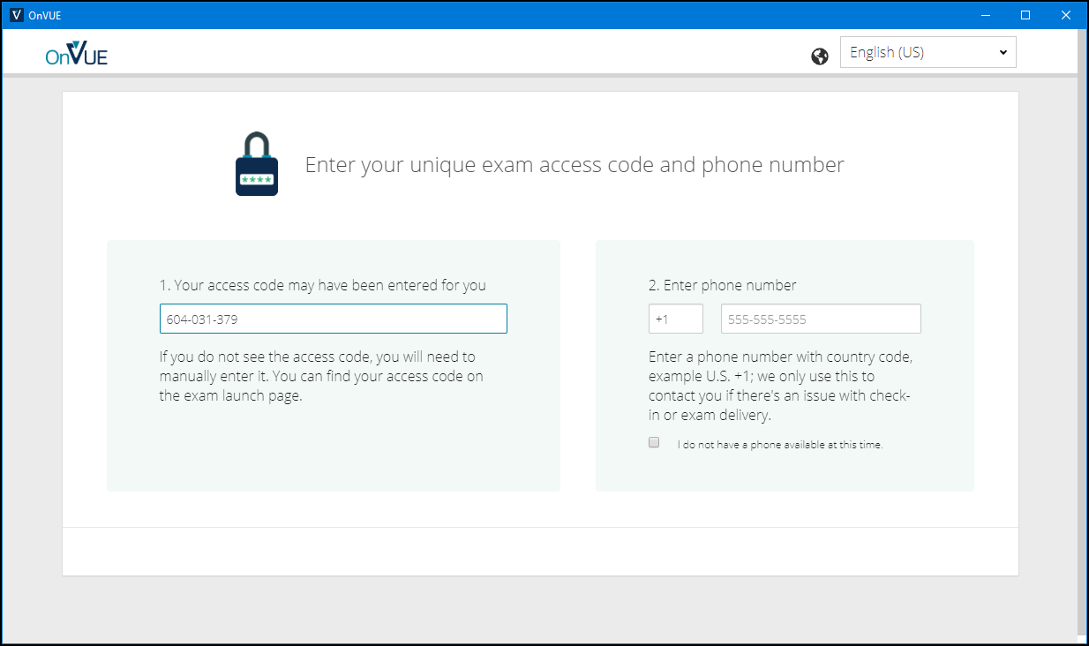
Pearson OnVUE Check-In

Slide 86
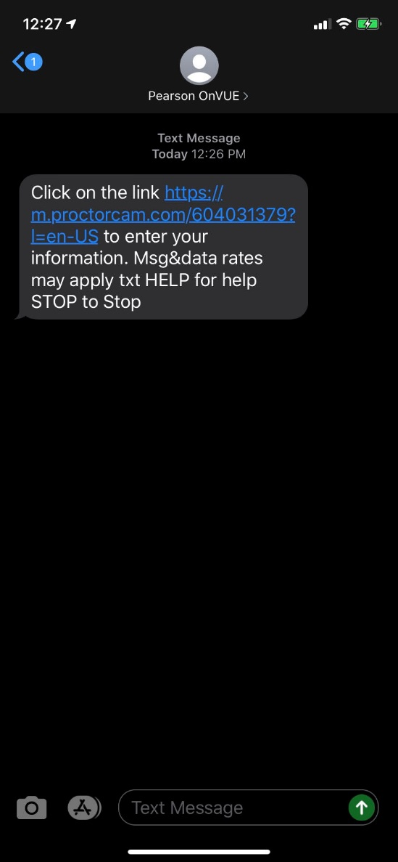
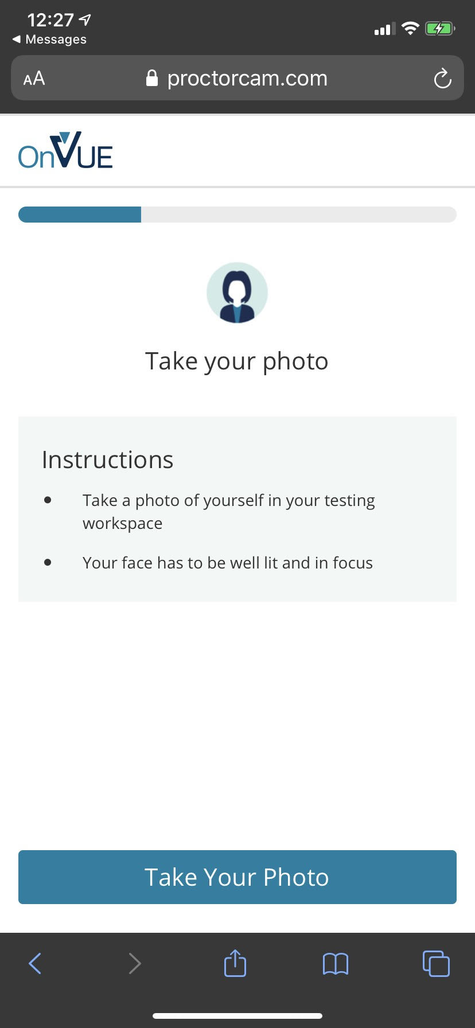
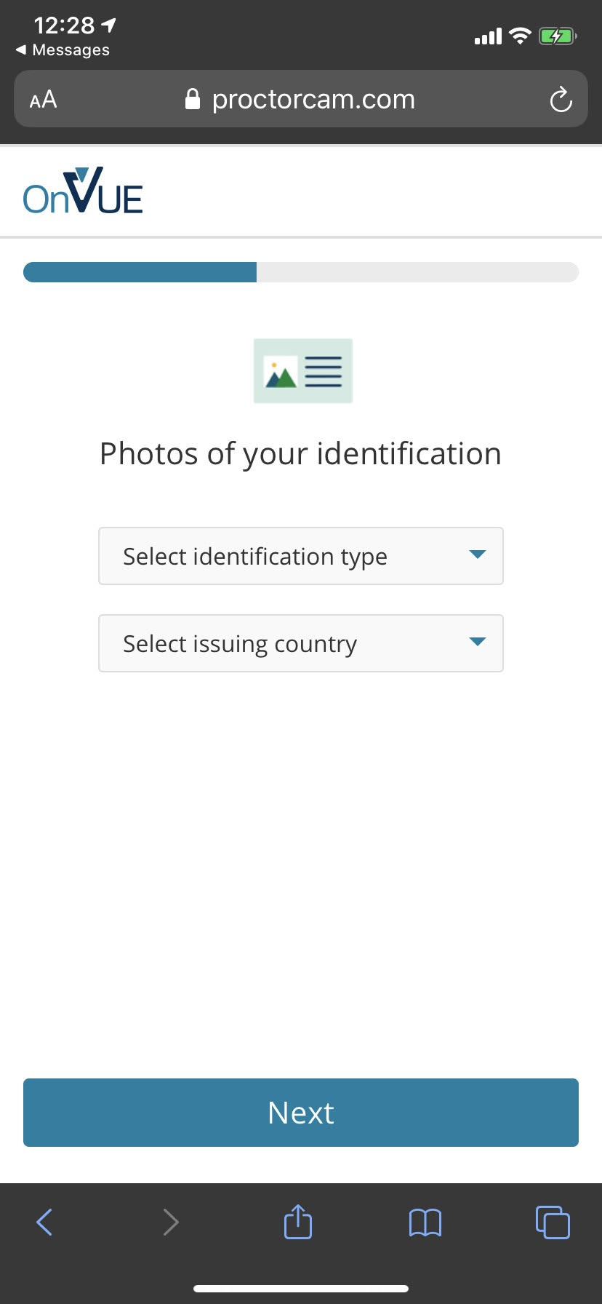
Pearson OnVUE Check-In

Slide 87
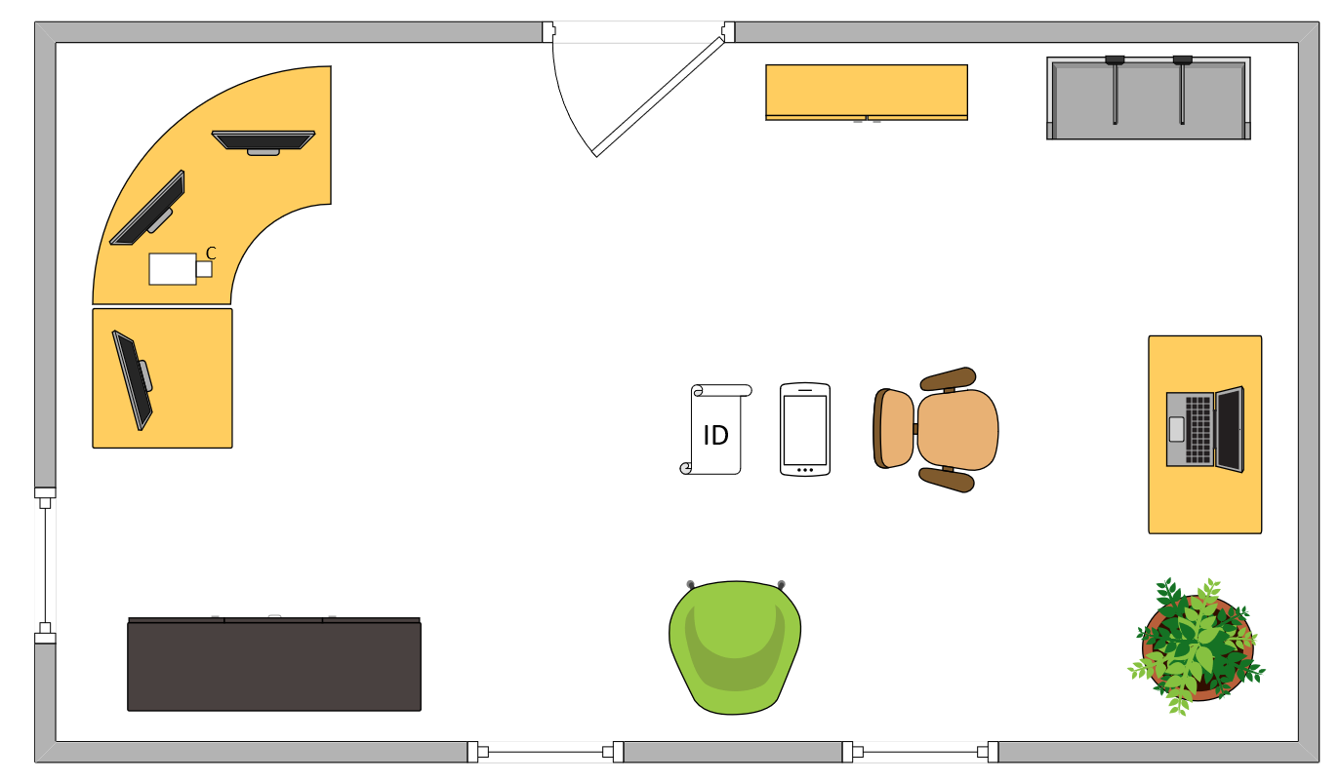
Tim’s Ideal Testing Room
No interruptions or bio breaks
Cover monitors and cameras
Pull back for environment photos
Clear table with laptop

Slide 88
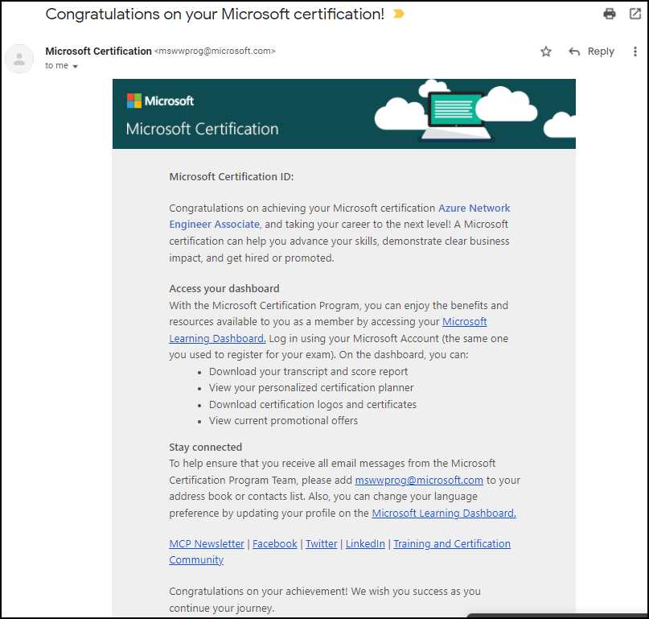
Congratulations!

Slide 89
AZ-305 Exam Strategy
Focus your skills accordingly:
60 percent Azure portal
20 percent Azure PowerShell
10 percent Azure CLI
10 percent KQL
Expect performance-based labs, but be thankful if you don't see 'em

